Slide 1

Hand pose estimation in single RGB image with Multiview Bootstrapping
Bangladesh Army University of Science and Technology, Saidpur
Submitted By:
1. Mohammad Montasim-Al-Mamun Shuvo (160201059)
2. Abid Hasan (160201060)
Supervised By:
Prof. Dr Md Mamunur Rashid
Dean, Faculty of ECE
Professor, Department of CSE
&
Co-Supervised By:
Mohammad Hasan
Lecturer
Department of CSE

Slide 2
⨳ Overview
2
1
Introduction
2
Background and Present State of process
3
Objective with Specific Aims
4
Methodology
5
Outline of Methodology Design
6
Dataset and Model
7
Flowchart
8
Result and Discussion
9
Reference

Slide 3
⨳ Introduction
3
Hand Pose Estimation
Method
Hand pose estimation is the task of finding the joints of the hand from an image or set of video frames.
We have used Multiview Bootstrapping to detect
Hand Pose
Hand finger localization
Multiview Bootstrapping
Reference Paper said that
An effective algorithm is needed
The method is used to train a hand Key-point detector for single images.

Slide 4
⨳ Background and current state of the problem
4
Authors | Method | ML Algorithm | Accuracy | Pos | Cons
Pramod Kumar P [2010] | Shape and texture-based features. Biologically inspired features | Visual Pattern Recognition, SVM classifier. | 94.36% | Handle complex natural background, dynamic gestures | Less accuracy with body part
Zimmermann [2016] | 3D Hand Pose from Single RGB Images | Deep Neural Networks (DNN), learning based method | 64.84% | Low computational and implementation cost, Lightweight, | Key point ambiguity, Fewer details, perspective distortion

Slide 5
⨳ Background and current state of the problem
5
Authors | Method | ML Algorithm | Accuracy | Pos | Cons
Gyeongsik Moon [2019] | Depth map image 3D voxel representation | CNN, Gaussian distribution | 83.44% | No perspective distortion. | Computational complexity, High performance hardware needed, Time-consuming

Slide 6
⨳ Objective with Specific Aims
6
1
2
3
Try to implement Multiview Bootstrapping for Hand Pose detection
Hands pose detection
Find finger localization

Slide 7
⨳ Method – Multiview Bootstrapping
7
It is a learning technique which is improved its accuracy by multiple views of the same object.
1
2
3
An initial key-point detector is used to produce noisy labels in multiple views of the hand.
The noisy detections are then triangulated in 3D using Multiview geometry or marked as outliers.
Finally, the reprojected triangulations are used as new labeled training data to improve the detector.
We repeat this process, generating more labeled data in each iteration.

Slide 8
⨳ Outline of Methodology Design
10
Start
Unlabeled images
For every frame
Key-point Detector
Frame?
Labeled training data
Run detector on all views
For iteration i
in 0 to K
Triangulate key-points from weak detections
Robustly triangulate key-points
i < K
i = i + 1
Score and sort triangulated frames
Improved detector and training set
Retrain with N-best reprojections
End

Slide 9
⨳ Model and Dataset
11
We have used CMU Panoptic Studio dataset. Features of this dataset
480 VGA camera, 640 x 480 resolution, 25 fps
31 HD cameras, 1920 x 1080 resolution, 30 fps
10 RGB-D sensors
5 DLP Projectors. synchronized with HD cameras
1
2
3
CMU dataset was trained using deep neural network.
The structure of the neural network is stored as a .prototxt file
Weight of the layers of the neural network are store as a .caffemodel file

Slide 10
⨳ Flowchart – Hand Pose Estimation and Finger Localization
12
Start
Input RGB image
Setup network and model
Find end key point of finger
Set fixed dimension of image for network
For every Pose-Pairs
Found 5 ?
Prepare input format for network
Pair?
Indicate points
For every points
If Part A and Part B
Display output
I < 22
I = I + 1
Draw line between A and B
Save output
Localize key points
Draw circle at A and B
End

Slide 11
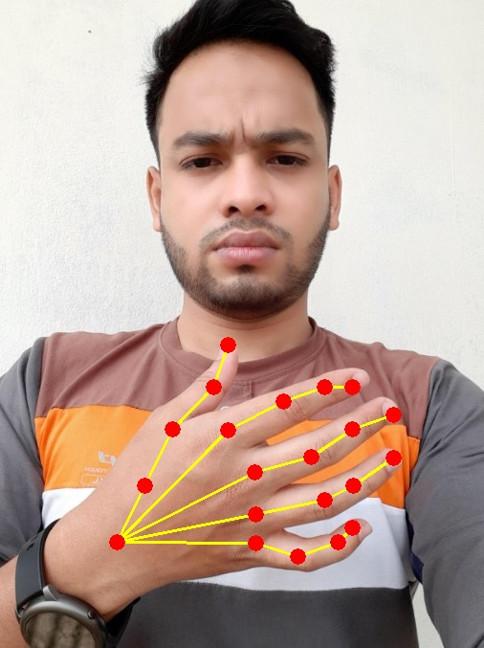
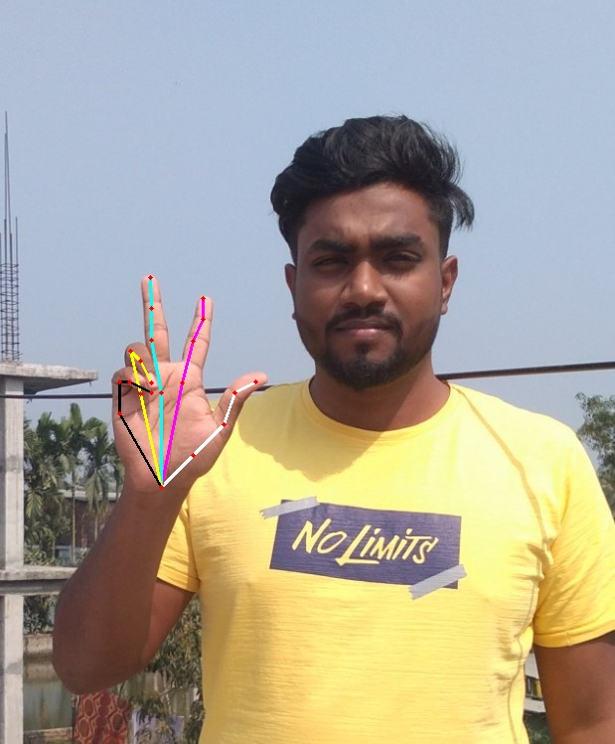
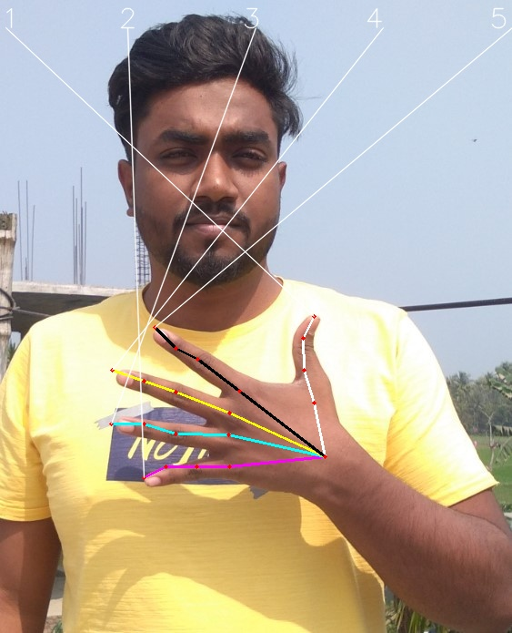
⨳ Result
13
• 1st result
• 2nd result
• 3rd result
• Hand detection
• Hand Pose detection
• Fingers classification
• Hand Pose detection
• Fingers classification
• Finger index localization

Slide 12
⨳ Result
14

Slide 13
⨳ Discussion – Our Findings
6
This paper presents two innovation
1
2
Hand Pose detection
Hand finger localization
Our method can be used to detect hand pose using hand keypoints detection. This can be used to generate hand pose that is prone to occlusions(e.g. body and face). We were also able to localize hand finger.

Slide 14
⨳ Discussion – Limitations of Our Work
7
Limitations of our work:
1
2
Quality of the picture is highly dependent to find accurate result.
Large Image height results with computational complexity

Slide 15
⨳ Reference
16
Reference of Our Work
Tomas Simon[2014]: Hand Key-point Detection in Single Images using Multiview Bootstrapping
Pramod Kumar P[2010]: Hand Posture Recognition Using Neuro-Biologically Inspired Features
Zimmermann [2017]: Learning to estimate 3d hand pose from single RGB images
Gyeongsik Moon[2019]: Camera distance-aware top-down approach for 3d multi-person pose estimation from a single RGB image
Dataset: http://domedb.perception.cs.cmu.edu/

Slide 16
THANK YOU

